Slide 1


Receipt Manager
12/2/25
The Receipt Managers
Team Members:
Nate Bagchee - Product Owner
Merrick Fort
Bronsen Lasala
Michael Tong

Slide 2
Application Domain
Motivation:
This project offered an opportunity to work with a variety of interesting technologies which was exciting
A campus organization and voiced their interests in spend management/receipt tracking
Users:
Frequent shoppers
Anyone trying to budget
Problem Addressed:
Itemization of shopping items
Transactions are true to the actual price of all the items

Slide 3
Goals
Set Out to Achieve
An app built for iOS
Utilizes the iPhone Camera to take photos of receipts
Scan on-device or process on server depending on performance.
Store receipts in a database connected to the user profiles to track purchases over time.
Use the database to display purchasing statistics per user for informed budgeting decisions.
Company profiles for employee/employer distinction
Have Achieved
All goals and stories except for company profiles
  Restricts our current user base to individuals

Slide 4
Biggest Challenges
For the Final Product:
  Being strict with acceptance criteria.
  Not getting over ambitious with new features.
  Adjusting design decisions based on remaining time in sprints when requirements evolved.
For Development:
  Organization & Planning with teammates.
  Resolving merge conflicts while maintaining functionality.
  Consistently classifying items for all receipt types.
  Working within Xcode and the underlying dependency management.

Slide 5
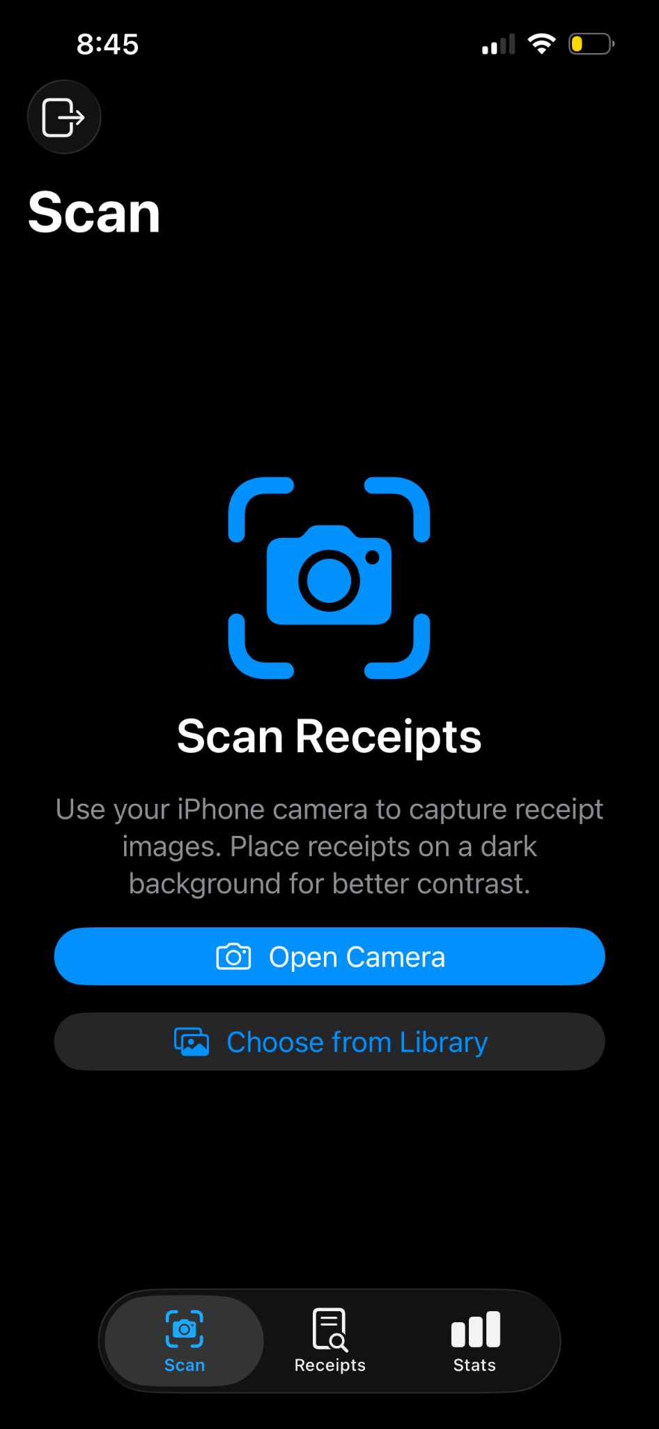
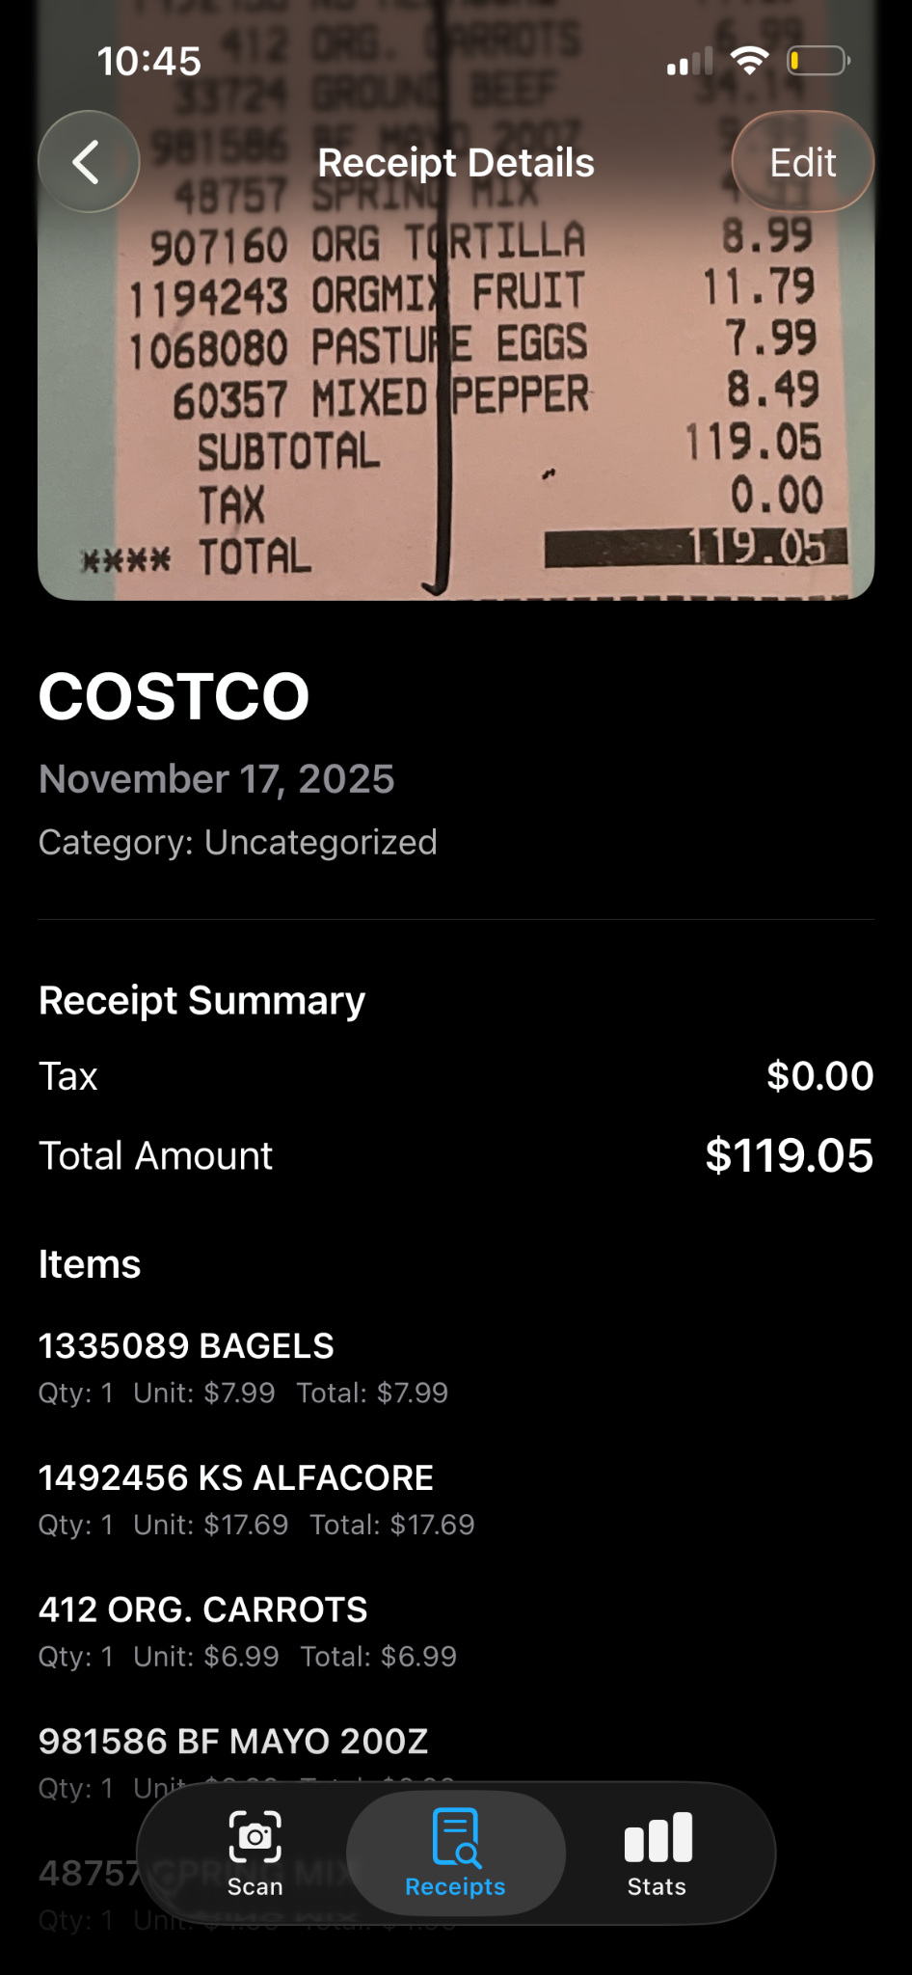
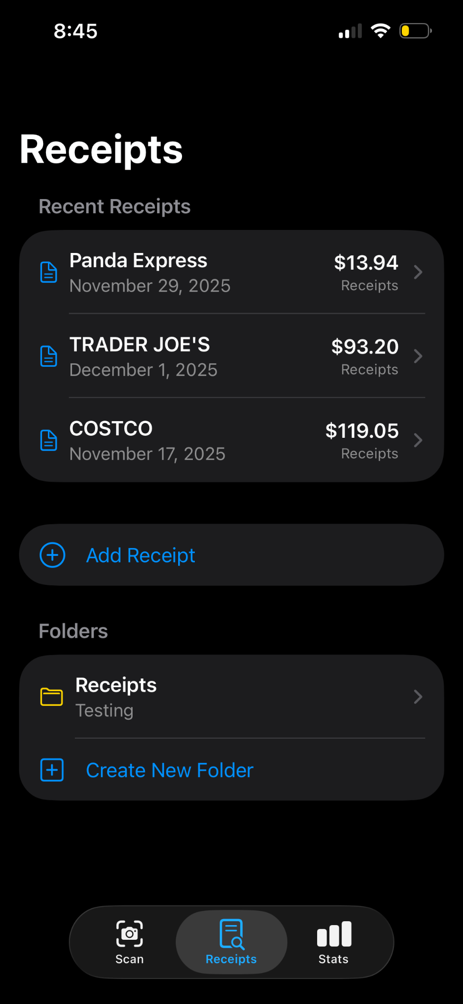
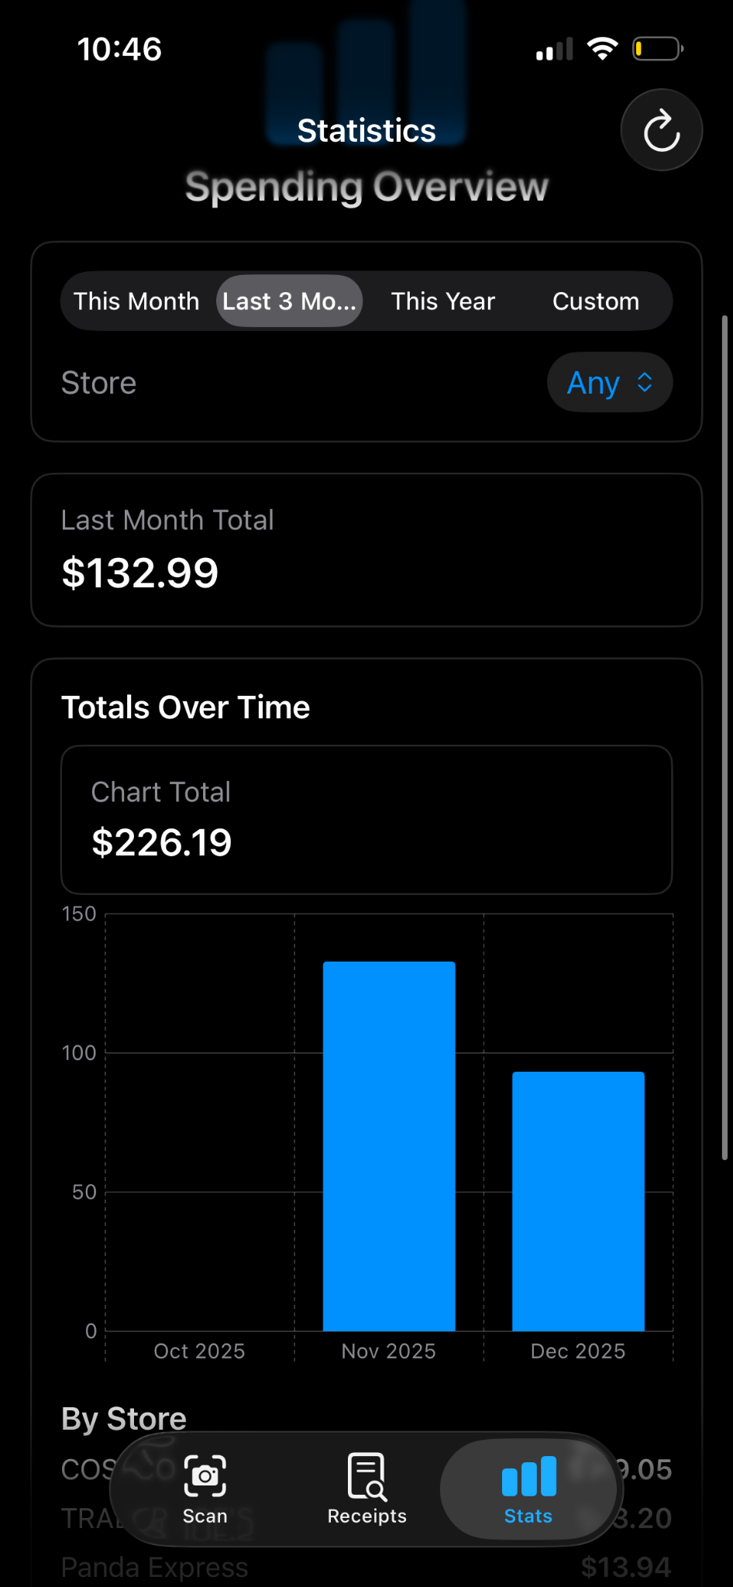
System Screenshots

Slide 6
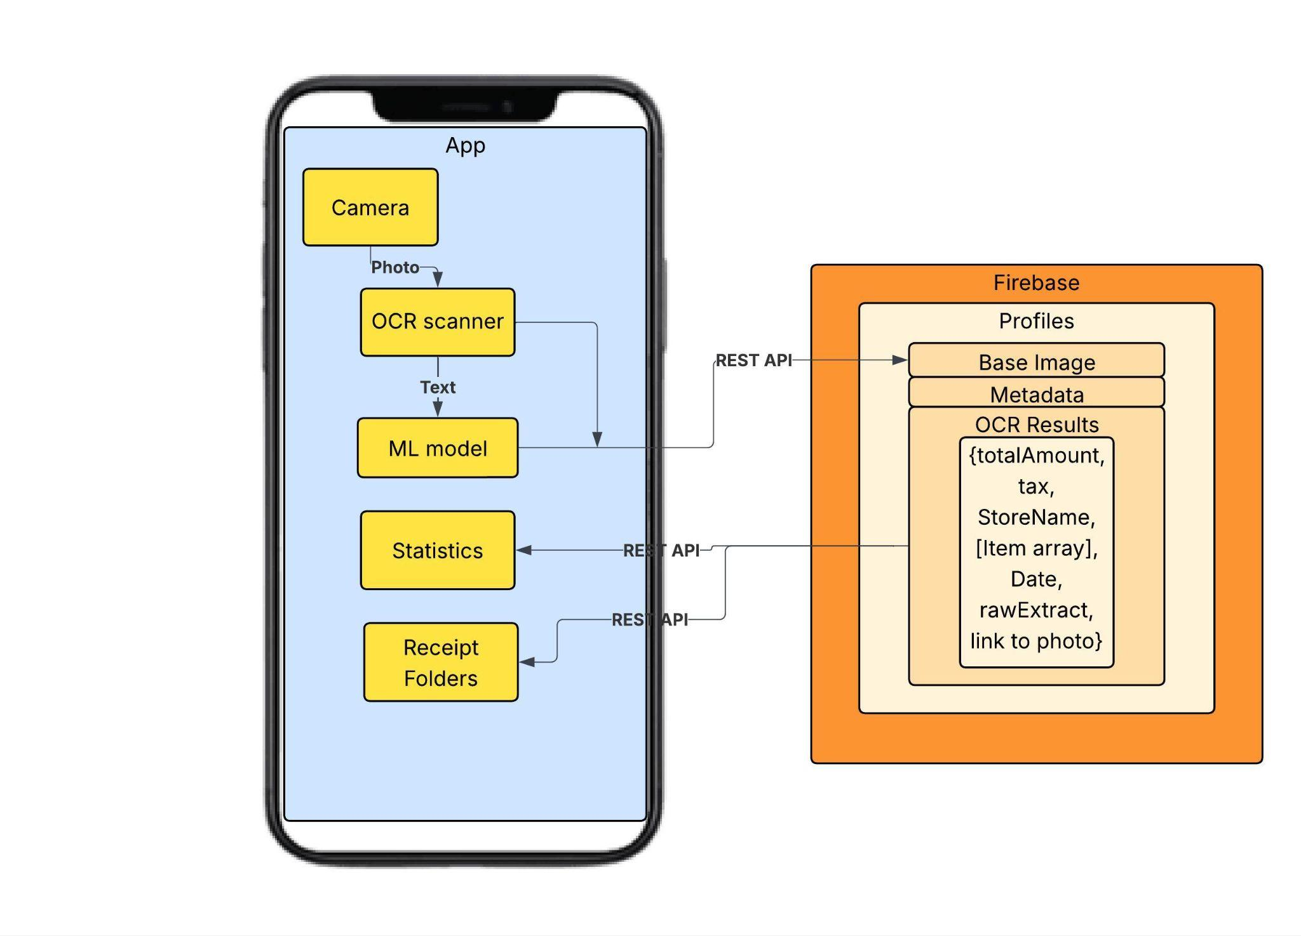
System Diagram

Slide 7
Technologies
Camera
Implemented using AVFoundation (Swift)
Provides real-time camera preview, multi-shot capture, and control over exposure/focus
OCR Scanner
Apple Vision (VNRecognizeTextRequest) was used in its construction, creates tokens and raw text blocks from captured images.
ML Framework
A dataset was built (using real OCR outputs) and trained a Multinomial Logistic Regression Classifier for items
The rest (store name, totals, payment method, and tax) were parsed and extracted through regex rules
Module for Statistics
Aggregates user-level insights such as spending trends, per-store totals, and item-level summaries.
Filterable statistics by date
Folders for Receipts
Swift data models are used for local management within the application.
Synced remotely through Firebase APIs for consistency across sessions.

Slide 8
Project Management Techniques
Additions to Scrum:
Communicating when we pushed changes and had merge conflicts
Personal Check-ins with people that you working on a similar feature with
Deviations to Scrum:
Adding new features mid-sprint
Removing stories we did not have time for
Standups went longer than 15 minutes

Slide 9
Enjoyed/Not enjoyed
Enjoyed:
Developing a product with others over a longer period(We don’t do this in any classes)
Learning new technologies and frameworks
Constantly working on different tasks and changing responsibilities.
  Felt ownership of the whole system
Getting to experience a recreation of the Scrum process
Didn’t Enjoy:
Sharing a code base with multiple people
Hard to manage scrum with changing class loads and dependencies
Always working from a user perspective rather than a developer one.

Slide 10
Lessons Learned
What Worked:
Standups were a good way to ensure people were on top of work
Using the Scrum Board worked towards managing dependencies
Sprint plans with TAs helped highlight potential blockers and technology challenges way prior to facing them.
What didn’t:
Working with Merrick
Placeholder.
Placeholder.
What we could have done:
Delved more into Smart contracts and authentication
Cut down on our product backlog
More clearly define acceptance criteria to ensure no work was wasted/unnecessary

